Slide 1
Dexavier Tajaun Williams
Technical Designer
9/8/2019

Slide 2
Technical Designer
*Be the middle ground between artists and programmers.
*Put all the game elements into Unity.
*Be skilled in multiple ways to take care of the projects.

Slide 3
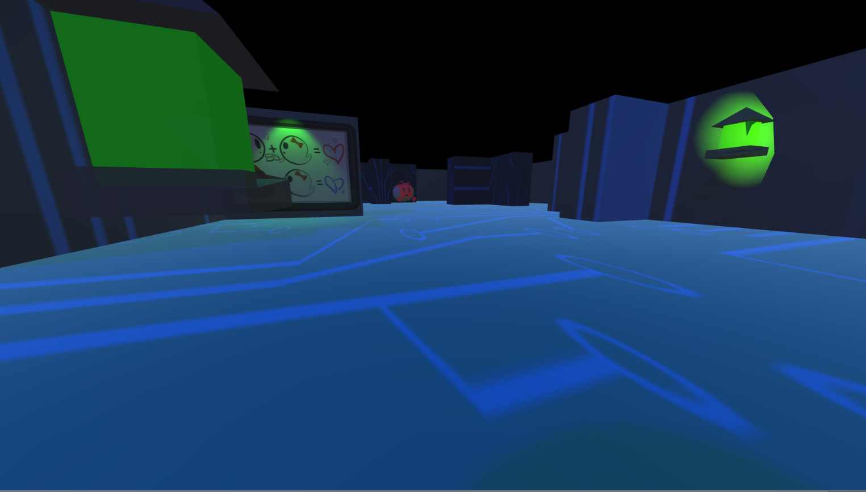
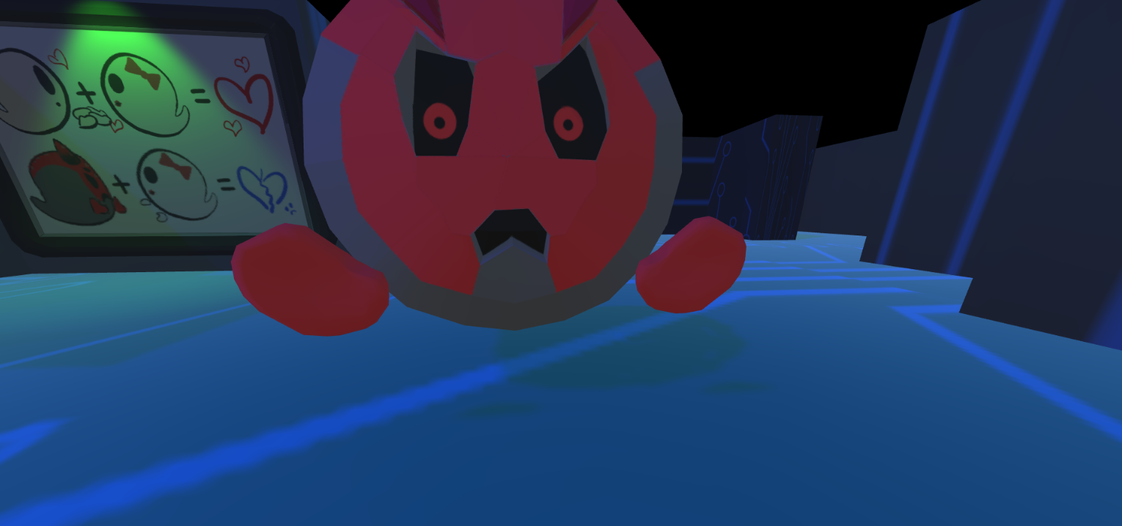
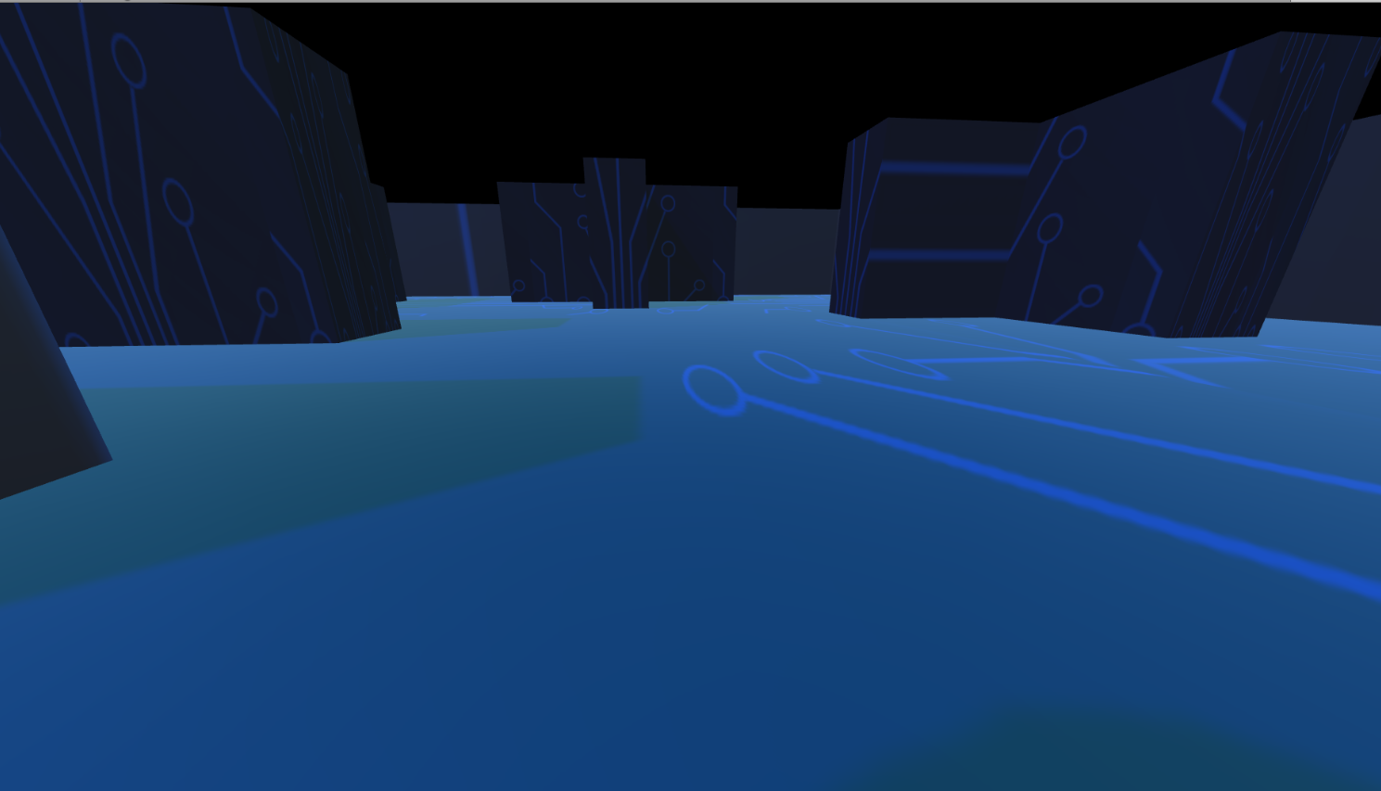
GHOST N’ BITS

Slide 4
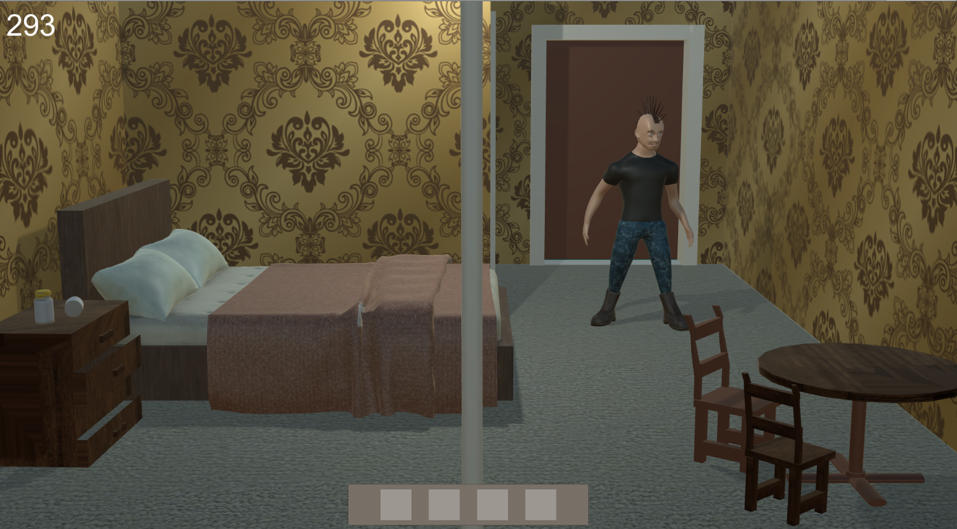
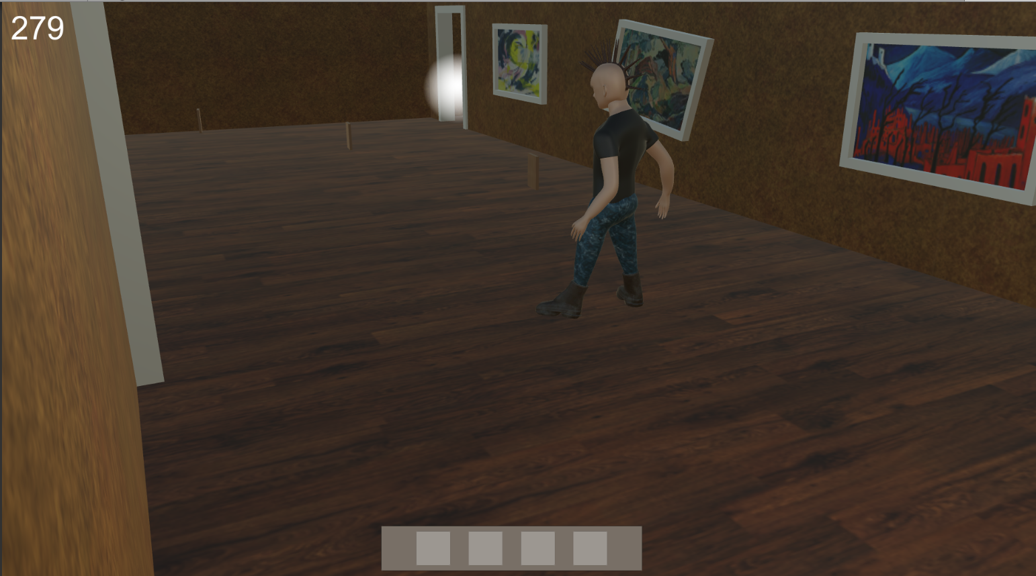
PsychoDelic’85

